Slide 1
SDG Localisation in Nagaland: Progress so far and way forward 30/05/2022

Slide 2
Contents
Institutional mechanism for implementation of SDGs
Progress so far of SDG localisation
SDG monitoring mechanism and dashboard
Way Forward
Best Practices
Challenges

Slide 3
1. Institutional mechanism
With technical support from United Nations Development Programme (UNDP), the SDG Coordination Centre (SDGCC) in the Planning & Coordination Department was established in September 2019 with a mandate to act as a dedicated centre for SDG knowledge dissemination, monitoring, policy strengthening, and as an accelerator of SDG implementation across the state.
Consituted High-Level Steering Committee headed by Chief Secretary on October 16, 2019 for guidance, monitoring, policy review and course corrections.
Departmental SDG Cells in all relevant departments have been created with Nodal officers.
District SDG Committee constituted at all Districts under the chairmanship of Deputy Commissioner.

Slide 4
2. Progress so far (1/3)
Released SDG 2030 Vision Plan for Nagaland
SDG 2030 Vision Plan outlines current interventions, challenges associated with ongoing programmes,proposed strategies to achieve the SDG Vision 2030 and priority indicators with target values. It has been prepared through a participatory approach to create a holistic pathway for inclusive development of Nagaland
Capacity building for taking forward, localising the SDGs and quality data updation:
State-level capacity building workshops and consultations held
District-level workshops held in 2020 and 2021 across all 12 districts of Nagaland
State and District Indicator Framework
Finalized the State and District Indicator Framework aligned to National Indicator Framework after extensive consultations with the concerned departments

Slide 5
2. Progress so far (2/3)
Progress so far (2/3)
Mapping of all ongoing Central Government and State Government schemes with the relevant SDG indicators has been completed
Released SDG District Manual for SDG localisation and integration
Published brochure contextualising the SDGs in North East India
Monitoring and Evaluation
Identified focus indicators and focus districts based on State performance in the SDG India Index and NER District SDG Index for focused interventions and frequent review by Depts/Districts
SDG Dashboard for Nagaland being developed as a single platform for SDG data collection, monitoring and analysis

Slide 6
3. Progress so far (3/3)
Progress so far (2/3)
Strengthening SDG outreach and dissemination
Developed publicity material, an SDG Promotional Video and radio jingle for localizing SDGs across the state which was widely disseminated through all media and social media platforms
Released first and the second editions of SDG Newsletter aligned to COVID-19 responses
SDG one stop destination counter at the Hornbill Festival 2021 for dissemination on the SDG agenda which received wide appreciation
Organised a Green Christmas campaign for greater awareness and encourage on-ground action towards localisation of the SDGs
Implementing three innovative projects as part of ‘SDG Innovation Participatory Action Research Initiative’ for fast-tracking the priority SDGs
SDG dissemination through online quiz and All India Radio Kohima

Slide 7
.
3. Progress so far (4/4)
Progress so far (2/3)
Trainings conducted on LSDG’s
SIRD, Nagaland had conducted a Pilot Training on LSDGs in Kohima District
“Training on Localization of Sustainable Development Goals through Village Functionaries”
Sl.No. | Training date | RD Blocks | Venue | Level of Participants | Resource Person
1 | 23-24 May 2022 | Chiephobozou & Botsa | BDO Conference Hall, Chiephobozou | VCCs & VDB Secretaries | Dr.Kedise Pucho, Principal, ETC Phek, SIRD.
2 | 25-26 May 2022 | Kohima, Jakhama & Sechu | Red Cross Conference Hall, Kohima | VCCs & VDB Secretaries | “

Slide 8
4. Monitoring mechanism and dashboard
The SDG Dashboard specific to Nagaland indicators is in process. This dashboard will help in the regular availability of quality and accurate data, real-time monitoring, analyzing and streamline the process of implementation of the SDGs.
A single point source for SDG data at State and District level with provisions for Programmes & Schemes, Baseline, Targets, Action Plans, Ranking, Financial Allocation & Expenditure

Slide 9
5. Way forward (1/2)
Timelines for localization of SDGs training 2022
SI SIRD Nagaland Action Plan on localization of SDGs 2022 RD Nagaland Action Plan on loc SIRD Nagaland Action Plan on localization of SDGs 2022:
SI SIRD Nagaland Action Plan on localization of SDGs 2022 alization of SDGs 2022
Sl.No. | Date | Meeting | Level of Participation | Resource Person | Agenda
1 | June 2022 | Departmental coordination meeting under CS Chairmanship | Comm. Secretary/ Secretaries | Planning Department & SIRD | Finalising action plan of the State for SDG localisation
2 | June 2022 (3 days) | Awareness program on LSDGs | Departmental Nodal Officer | SIRD | Sensitisation of State Departments
3 | July 2022 (3 days) | Training on LSDGs for District Officers | Departmental District officers | Planning Dept. SIRD Faculty & RD. | Sensitisation of District Departments
3 | August 2022 (3 days) | Training on LSDGs | Departmental Field Officers | SIRD | Sensitisation of Field Officers
4 | August-Sept 2022 (3 days) | LSDGs through Village Functionaries | VCs & Secretaries VDB | Planning Dept,SIRD & RD | Sensitisation at village level

Slide 10
5. Way forward (2/2)
Village level localisation: All village development plans to be aligned to the SDGs indicators and targets along with appropriate monitoring mechanisms at local level.
Convergence: Convergence among all the line departments will be encourage to implement all the 9 themes at the village level
Resource Mapping: Localised resource mapping will be carried out to integrate the SDGs and aligned to the SDG targets
To adopt SDG Model Village/s to showcase a replicable model where SDGs has been integrated.
Capacity Building: Will continue to provide handholding support to all concerned state ,district level officials and village level officials for localising and integrating the SDGs and for quality data collection and timely updation on the system- Nagaland SDG dashboard.
Strengthen District-level Institutional Mechanism: A District SDG Cell headed by the Deputy Commissioner with all relevant department Head of Offices in all districts will be strengthened for effective implementation and monitoring of the performance of the SDGs at ground-level.
Strengthen SDG outreach mechanisms at Block and village levels by engaging VCs, VDBs and prominent youth leaders and local civil society organisations for sensitization and dissemination in the different thematic areas and relevant SDG’s

Slide 11
6. Challenges
Lack of interdepartmental coordination
Inability to relate to the SDG indicators framework
Aligning customary laws to the SDGs
Aligning the local challenges to the SDGs

Slide 12
Best Practices
In 1980-81 the idea of grass root level planning and development became a reality following with the enactment of “The Nagaland Village & Area Council Act 1978” and the constitution of the Village Development Boards (VDBs) in all the recognized villages of the State.
VDB is the developmental agency of the village, which functions under the Village Council. It comprises of the General Body which is composed of representation of the whole village community.
A Management Committee where a women representation of one fourth of the Management Committee members and youth representation are compulsory to ensure that any development activity in the villages benefit the entire community.
The powers conferred on the Village Councils for the purpose of formulation of plans and implementation of developmental programmes have been devolved to the VDBs in all the Villages.
Under the Rural Development Department, all the developmental activities in the rural areas of Nagaland are undertaken by the Village Development Boards ((VDBs) by improving the economic and social living standards of the rural poor through employment generation and infrastructural development programmes.

Slide 13
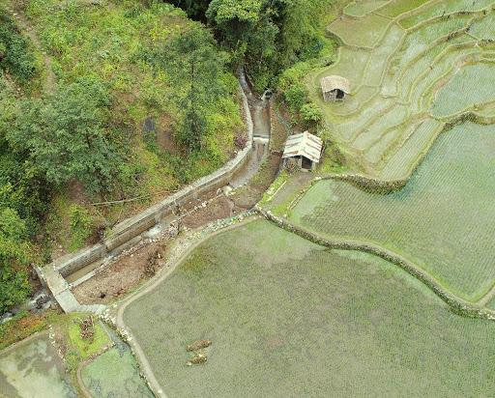
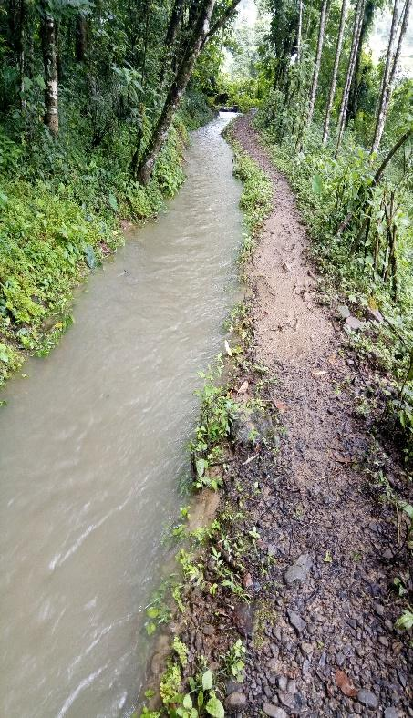
Water Sufficient Village: Kigwema of Jakhama block
Kigwema, located on the foot of Mt. Japfü takes pride as one of the oldest traditional villages from where many Tenyimia villages took birth. A village blessed with geographically, climatically, not to exclude its locational advantages, has the largest traditional terrace cultivation in Nagaland.
The water channels for about two decades were abandoned as a result of heavy damages and had to be reconstructed and rejuvenated under MGNREGA and XVFC.

Slide 14
Khonoma Green Village- Asia’s first green village in Nagaland
The village by a resolution has prohibited all hunting,logging,bio-prospecting and even collection of wild vegetables

Slide 15
Good Governance initiatives at Zapami Village
Best Practices : Good Governance initiatives at Zapami Village
One of the best practices established at Zapami village is the Heritage Musuem, the museum was created with an aim and a motive of preserving the rich and unique cultural heritage, and the idea of collecting antiques from individual houses and deposting it in a museum for preservation, documentation and exhibition. The museum is now serving as tourist attraction, whilst generating revenues for the village.
Some of the other Good Governance Initiatives are :-
1. One family, one project is to be emphasised during the year 2022.
2. Since 2010, village sanitation day is observed on 16 March in commemoration of Nirmal Gram Puraskar award.
3. Summer Schools : During summer, students from the urban sectors will be encouraged to come and learn the traditional agricultural practices.
4. Winter Schools : During winter, Village elders shall impart knowledge and skills on village history, traditional practices, folklores, folktales, folksongs, folkdance, traditional dance.
5. The VC and the VDB proposes to construct traditional houses for visitors and tourist to come and experience the Zapami traditional village life.
6. Plastic free organic traditional market, selling only the products of the village.

Slide 16
Thank You

